Slide 1

Spreadsheet Applications
GCSE Digital Technology | Chapter 4

Slide 2

Specification Breakdown
describe the following basic structures of spreadsheet software: cells, rows and columns;
describe and use the following features of spreadsheet software:
  data types;
  templates, headers and footers, conditional formatting, validation, and importing data;
  entering text, numbers and formulae;
  formatting cells, rows and columns;
  creating and replicating formulae;
  creating a simple template for others to use;
  using simple functions, relative and absolute cell referencing, IF statements and VLOOKUPs;
use a spreadsheet for data modelling;
create, label and format charts;
create simple macros.

Slide 3

What actually is a spreadsheet?
A spreadsheet is an application often used to process and display financial or statistical information, where data is organised in a grid layout consisting of rows and columns.
It is used by people in many different occupations such as engineers, scientists, teachers, designers and people who run their own business.
It contains one or more worksheets
Used to create/manipulate data
Can perform calculations

Slide 4
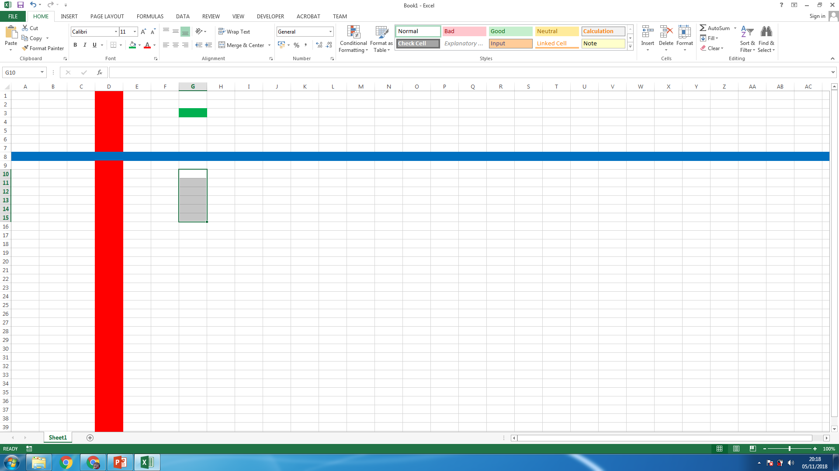
Cell
Range of Cells
Column
Row
Formula Bar
Name Box

Slide 5
Features of a spreadsheet
Data Types
Many different types of data can be entered into a spreadsheet.
Formatting Data
Data within a spreadsheet can be given certain formatting, including:
Labels (Text)
Values (Numbers)
Formula
A piece of text used to identify the contents of a row or column.
i.e. Name, Age
These must be entered in to allow for calculations to be carried out.
i.e. 5, 23
A formula is an instruction to carry out a calculation
i.e. = A1 + B1
Text (General)
Currency
Time
 Data Types_______
Formats applied to cell contents to specify stored data (e.g. Currency, Real/Number, Text/String, Date/Time, Boolean).
Number (real)
Date
Percentage

Slide 6

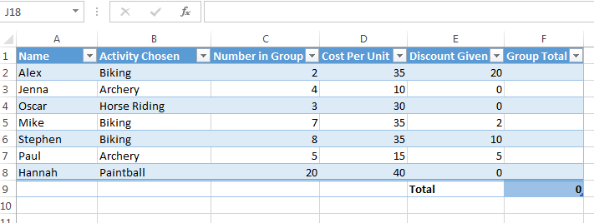
General/Text
Number
Currency
Date
Time
Percentage
Open Microsoft Excel and enter in the following data.
Within the Home tab, use the dropdown to format the data using a suitable data format.
Extension Task
Format the whole data as a table.
Add a total at the bottom which adds the total cost for a group

Slide 7
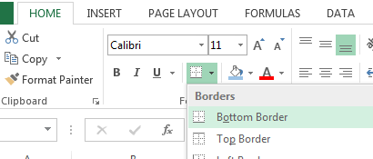
Making a Spreadsheet look good
Cell Formatting
We can add different styling to cells, including:
Borders
Background colours
Bold, Italic & Underlining
“Negative” money can be set to automatically change to red.
Wrap Text
 Template
A predesigned spreadsheet/document/layout that can be reused/used/edited to create documents with the same formatting and formulas.
Headers & Footers
 Merge Cells
Information or text placed at the top/bottom of a worksheet or document page to improve the presentation by displaying page numbers/etc.
Combining two or more adjacent cells into a single unified cell (often formatted as Merged and Centred).
 Importing Data
 Wrap text
Moving, transferring, or bringing digital content between software applications/platforms without having to re-enter the data (e.g. bringing CSV data into a table).
Formatting cell text so that long text strings wrap onto multiple lines within the cell border.

Slide 8

Simple Formulas
THE
GOLDEN
RULE
The Equals Sign =
GOES FIRST
A formula is a way a calculation is represented in a cell, using mathematical operators and references to other cells.
The formula is entered into a cell, but the display shows the current result of the calculation, which may change as the values in other cells change.
  All formulae start with an equals sign.
ADDING CELLS
= A1 + B1
Will add the contents of these two cells together
Multiplying CELLS
= A2 * B2
Will multiply the contents of these two cells together
Subtracting CELLS
= D1 - C1
Will subtract the contents of C1 from D1
Dividing CELLS
= A3 / A4
Will divide the contents of A3 by the contents of A4

Slide 9
Simple Functions
AVERAGE
=SUM(A1:A10)
Calculates the arithmetic mean of a specified range of cell values.

A function is used to do a very specific job within a spreadsheet
VLOOKUP
=VLOOKUP( “Blue”, A1:B2, 2)
Short for Vertical Lookup. This allows you to look up a value in a range of cells in a column and display that value. In this example, the number 20.0 is returned.
A function used to search for a value in a column or table cell range and return a corresponding value. Updates automatically if source data changes.
Autosum / SUM
=SUM(A1:A10)
A function used to add a range of contiguous cell values together.
A1 is the first cell in the range and A10 is the last cell in the range.
This formula will add A1 through to A10 together.
MAX
=MAX(A1:A10)
Identifies & returns the highest numeric value within a specified range.
 | A | B
1 | Blue | 20.0
2 | Pink | 1.0


MIN
=MIN(A1:A10)
Identifies and returns the lowest numeric value within a specified range.

IF
=IF(A1> 60, “PASS”, “FAIL”)
If the contents of cell A1 is greater than 60 then the word PASS will be entered, if it lower than 60, the word FAIL will be entered.
Used to evaluate a condition and return or change a formula value in a cell if a condition is met.


Notes:
VLOOKUP will be shown later

Slide 10
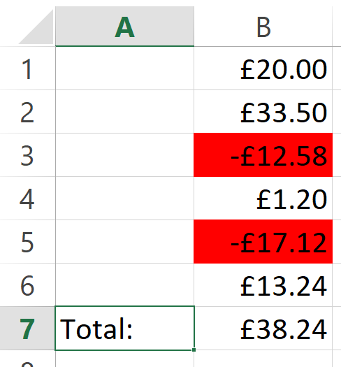
Activity: Part B
 Conditional Formatting__
Automatically highlights or formats cells if a specified condition is met (e.g. automatically highlighting hours worked > 40 in a different colour).
A mistake was made! It should have been –£20.00 in cell B1.
I was really bad and it should have been a positive number in cell B3. Fix this also.
When we change this, we shouldn’t have to manually change the background colours – this just adds another possibility of doing something wrong.
Instead, we should use conditional formatting

Slide 11

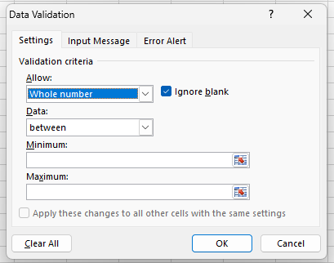
Validation
 Data Validation __
An automatic computer check that ensures data entered is sensible and reasonable, and within acceptable limits at the input stage. It cannot check the data entered is correct.
We can ensure data being entered is suitable
We can also ensure a certain data type is entered
Want to display a message to the user if the data isn’t entered correctly? We can do that using an Error Alert.
This can encourage the user to retry entering valid data.

Slide 12

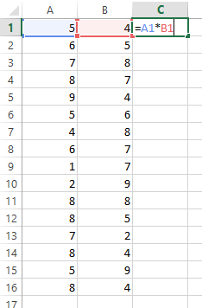
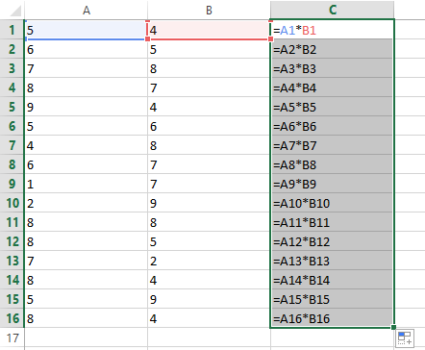
Replicating Formula
 Replicating Formulae______
Copying a formula down or across cells (by dragging or pasting), where the spreadsheet automatically changes row numbers to match the row being used (saves time).
This is known as the fill handle.
Click and Drag this down will allow you to replicate the formula for the other calculations.
Notice how the cell references also change. Unless absolute cell referencing is used, spreadsheets rely on relative cell referencing.
When a formula is replicated, the software automatically adjusts the cell references (row numbers or column letters) to match the row or column being used.
Notes:
Relative and Absolute Cell referencing defined on next slide

Slide 13

Relative Cell Refencing
A cell reference that stays the same / does not change when the formula is copied, replicated, or dragged down.
i.e. $B$9.
A cell reference that changes when the formula is replicated.
i.e. B9.
Absolute Cell Refencing
Pro Tip: Absolute cell Refencing is tested in almost every exam series. Always remember to state that the cell reference does not change when copied or replicated and mention the $ sign

Slide 14

IF Statements
PSEUDOCODE
IF <condition is true> THEN
<action 1>
ELSE
<action 2>
ENDIF
EXCEL IF STATEMENT
IF( <condition is true> ,
<action 1>
,
<action 2>
)

Slide 15
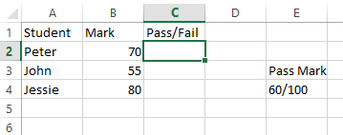
IF Statements
EXCEL IF STATEMENT
IF( <condition is true> ,
<action 1>
,
<action 2>
)
B2 >= 60
“Pass”
“Fail”
This can also be written in one line,
IF(B2>=60, “Pass”, “Fail”)

Slide 16
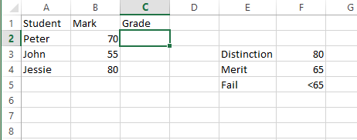
IF Statements
EXCEL IF STATEMENT
IF( B2>=80,
“Distinction”
,
IF( B2 >=65,
“Merit”
,
“Fail”
)
)
We can also add an IF statement into another IF statement. The inner IF statement can be said to be nested.
This can also be written in one line,
IF( B2>=80, “Distinction”, IF( B2 >=65, “Merit”, “Fail”))

Slide 17
VLookup
=VLOOKUP(“Rock Climbing”, A1:B5, 2, FALSE)
Termed ‘Vertical Lookup’
Looks at a value in a table and returns a specific value from a specified column in the same row.
So, we can find the activity ‘Rock Climbing’
…but return the price instead!
Activity | Cost
Safari Walk | £5.00
Swimming Lesson | £15.00
Rock Climbing | £10.00
Archery | £12.50

Slide 18
What is Data Modelling?
 Data Modelling __
Changing input values in a spreadsheet model to predict outcomes and analyse the impact of changes (e.g. changing tax rates or unit prices to evaluate total cost).
A model is created to replicate a real-life situation. In a spreadsheet application, a model can be created using different functions and formula to see what impact a change in the data entered by the user may have on other data held in the spreadsheet. This can then be used to help users make important decisions.
For example, business users could assess the impact a change in unit price may have on their overall profit (what-if), or teachers could use a spreadsheet model to work out how many marks a student needs to achieve a particular grade, based on what they have achieved so far. Spreadsheets can also be used to forecast. For example, if sales of a product continue to g

Slide 19
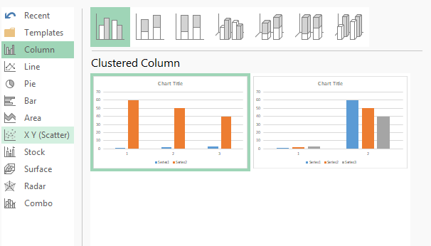
Data Modelling: Charts and Graphs
Tools used to visually represent data (e.g. Bar/Column chart, Pie chart) to compare values or show percentages of a total.
Lots of different chart types are available. The most common are:
  Bar Charts
  Pie Charts
  Scatter Charts
Charts and graphs can be copied into other software applications such as word processing or presentation software.

Slide 20
Macros
 Macro __
A small program or set of instructions used to perform a repetitive task, usually initiated through a click of a button.
A macro is a small program created to perform a repetitive task. It allows the user to perform a task by using the macro rather than having to enter the individual instructions.
If the task is likely to be used many times it is much easier and more user friendly to use a macro.
It is a set of commands/instructions recorded together that can be activated by a mouse click or pressing a key.
In simple terms it is a short cut to a task. A macro is created by recording the tasks to be carried out. It can then be named and saved. You can also write a macro using a script editor.

